Slide 1

Java 8 – New Features
Dima Ionut Daniel

Slide 2
Contents
What is Java?
History
Java Flavors
New Features
Lambda Expressions
Streams
Default methods
Data Parallelism
Date Time API
Nashorn JavaScript Engine
Concurrency Enhancements
JavaFX
JVM Internals
Other Improvements
Conclusions
Bibliography

Slide 3

What is Java?
Java is a programming language created by Sun Microsystems.
Java is used in a wide variety of computing platforms from embedded devices and mobile phones on the low end, to enterprise servers and supercomputers on the high end.
Memory management is handled through integrated automatic garbage collection performed by the JVM.
The heart of the Java platform is the concept of a "virtual machine" that executes Java bytecode programs. This bytecode is the same no matter what hardware or operating system the program is running under.
There is a JIT(Just-In-Time) compiler within the Java Virtual Machine, or JVM. The JIT compiler translates the Java bytecode into native processor instructions at run-time and caches the native code in memory during execution.
The Java programs are cross-platform or platform independent, but the code of the Java Virtual Machines (JVM) that execute these programs is not.

Slide 4
History
The initial Java release was named Oak, and the first stable version was JDK 1.0.2, called Java 1.
JDK 1.0 - 23 January 1996
JDK 1.1 – 19 February 1997
J2SE 1.2 – 8 December 1998 (codename Playground)
J2SE 1.3 – 8 May 2000 (codename Kestrel)
J2SE 1.4 – 6 February 2002 (codename Merlin)
J2SE 5.0 – 30 September 2004 (codename Tiger)
Java SE 6 – 11 December 2006 (codename Mustang)
Java SE 7 – 7 July 2011(codename Dolphin)
Java SE 8 – 18 March 2014 (codename Spider)
Java SE 9 – planned for 2016

Slide 5
Java Flavors
The Java distribution comes in different flavors:
Java Card →run securely on smart cards and similar small-memory devices.
Java ME(Micro Edition) → Specifies several different sets of libraries (known as profiles) for devices with limited storage, display, and power capacities.
Java SE(Standard Edition) → for general-purpose use on desktop PCs, servers and similar devices.
Java EE(Enterprise Edition) → Java SE plus various APIs useful for multi-tier client–server enterprise applications.

Slide 6
New Features
JSR 335: Language-level support for lambda expressions under Project Lambda and default methods
JSR 223: Project Nashorn, a JavaScript runtime which allows developers to embed JavaScript code within applications
JSR 308: Annotation on Java Types
JSR 337: Repeating annotations
JSR 310: Date and Time API
Statically-linked JNI libraries
Launch JavaFX applications
Remove the permanent generation
Java 8 is not supported on Windows XP.
Java 8 includes Java Mission Control.

Slide 7
Lambda Expressions
A lambda expression is a block of code with parameters.
We can use a lambda expression whenever we want a block of code executed at a later point in time.
Lambda expressions can be converted to functional interfaces.
Lambda expressions can access effectively final variables from the enclosing scope.
Method and constructor references refer to methods or constructors without invoking them.
New java.util.function package was added in Java SE 8.

Slide 8

Lambda Expressions (cont.)
Lambda expressions in Java is usual written using syntax (argument) → (body).
Lambda syntax:
A lambda expression can have zero, one or more parameters.
The type of the parameters can be explicitly declared or it can be inferred from the context.
Parameters are enclosed in parentheses and separated by commas. Eg: (String a, int b, float c)
Empty parentheses are used to represent an empty set of parameters. Eg: () -> 42
When there is a single parameter, if its type is inferred, it is not mandatory to use parentheses. Eg: a -> return a*a
The body of the lambda expressions can contain zero, one or more statements.
If body of lambda expression has single statement curly brackets are not mandatory and the return type of the anonymous function is the same as that of the body expression.

Slide 9
Lambda Expressions (cont.)
A set of interfaces were added in java.util.function package:
Predicate: A property of the object passed as argument.
Consumer: An action to be performed with the object passed as argument.
Function: Transform a T to a U
Supplier: Provide an instance of a T (such as a factory)
UnaryOperator: A unary operator from T -> T
BinaryOperator: A binary operator from (T, T) -> T

Slide 10
Streams
The Stream interface is located in the java.util.stream package.
Unlike the Iterator, it supports parallel execution.
The Stream interface supports the map/filter/reduce pattern and executes lazily, forming the basis (along with lambdas) for functional-style programming in Java 8.
There are also corresponding primitive streams (IntStream, DoubleStream, and LongStream) for performance reasons.
The Collection interface has two 2 methods for creating streams:
stream(): Returns a sequential Stream with the collection as its source.
parallelStream(): Returns a possibly parallel Stream with the collection as its source.

Slide 11
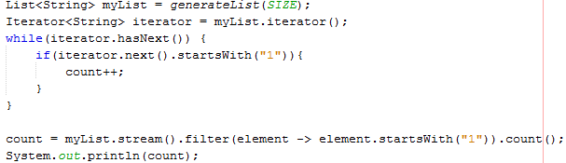
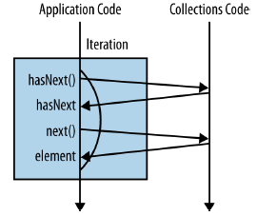
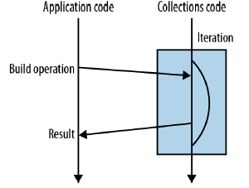
Streams (cont.)
A new addition was added to Collections API: Streams.
Streams allows the writing of collections-processing code at a higher level of abstraction.
The stream() method performs the similar role to the call as iterator().

Slide 12
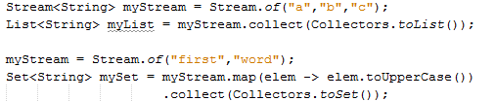

Streams (cont.)
Stream object can be converted to Set, List or individual operation can be performed on List elements based on different methods.
Filter method can be called on a stream to execute individual code when the elements are retrieved from Stream.

Slide 13
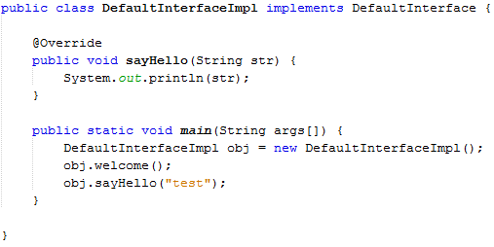
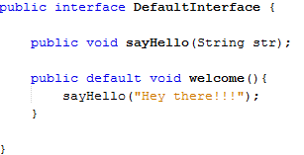
Default Methods
Default methods enable to add new functionality to the interface.
Default methods can be provided to an interface without affecting implementing classes.
An implementing class can override the default implementation provided by the interface.
Default method is different from the regular method in the sense the default method comes with default modifier.

Slide 14
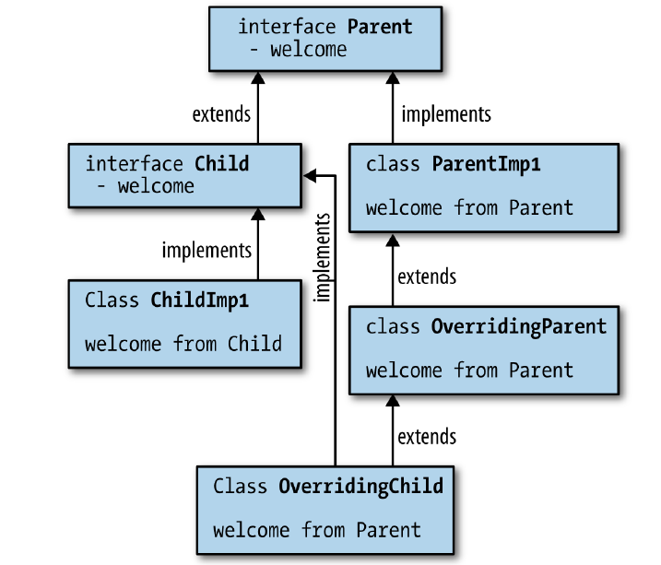
Default Methods (cont.)
The classes have priority than interfaces in case of inheritance.

Slide 15
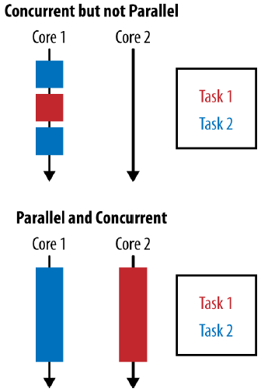
Data Parallelism
Concurrency occurs when 2 tasks are making progress at overlapping time periods.
Parallelism occurs when 2 tasks are happening at literally the same time such on a multicore CPU.
The goal of parallelism is to reduce a task by breaking it down into smaler components and performing them in parallel.

Slide 16
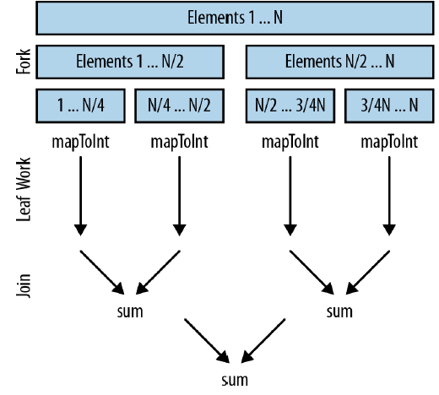
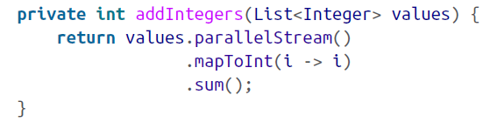
Data Parallelism (cont.)
Stream object has a method parallelStream() tht is executing streams in parallel.
Java 8 includes parallel array operations:
parallelPrefix
parallelSetAll
parallelSort

Slide 17
Date Time API
Time can be obtained via System.currentTimeMillis() which returns the current time in milliseconds from January 1st 1970.
To work with time offsets, add one month to a date, there is java.util.GregorianCalendar.
The Joda Time library is a useful date/time API.
Java 8 implements JSR 310(Date and Time API).
The ThreeTen project provides a reference implementation to this new API.
All java.time objects are immutable.

Slide 18
Date Time API (cont.)
The new API specifies a number of new classes:
continuous time: based on Unix time and is represented as a single incrementing number.
human time: based on fields that we use in our daily life such as day, hour, minute and second
API Classes:
Clock: access to current instant, date and time using a timezone.
Duration: time-based amount of time, difference between 2 Instant objects.
Instant: an instantaneous point on the time-line.
LocalDate: a date without a time-zone in the ISO-8601 calendar system.
LocalTime: a time without time-zone in the ISO-8601 calendar system.
LocalDateTime: date and time that has no zone information.
ZoneId: a time-zone ID, such as Europe/Paris.
ZoneOffset: a time-zone offset from Greenwich/UTC.
Period: a date-based amount of time in the ISO-8601 calander system.
Year: a year in the ISO-8601 calendar system.
DayOfWeek: day of week enum.
Month: month of year.

Slide 19
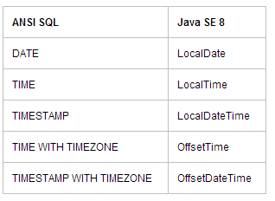
Date Time API (cont.)
The new API core ideas:
Immutable-value classes. One of the serious weaknesses of the existing formatters in Java is that they aren’t thread-safe.
Domain-driven design. Specific classes for Date and Time.
Separation of chronologies. Different calendaring systems was introduced.
JDBC in Java SE 8 will support these new types.

Slide 20


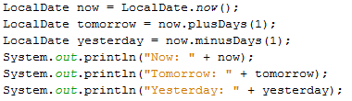
Date Time API (cont.)

Slide 21
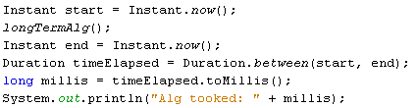

Date Time API (cont.)
A Duration is the amount of time between two instants.
It contains methods like: toNanos, toMillis, toSeconds, toMinutes, toHours,or toDays.
The DateTimeFormatter class provides three kinds of formatters to print a date/time value:
Predefined standard formatters
Locale-specific formatters
Formatters with custom patterns
The java.time.format.DateTimeFormatter class is intended as a replacement for java.util.DateFormat; for backwards compatibility, call formatter.toFormat().

Slide 22
Nashorn JavaScript Engine
Nashorn is the successor to the Rhino JavaScript interpreter, with greater performance and fidelity to the JavaScript standard.
Nashorn is very fast, and it lets you integrate Java with JavaScript on a highly performant virtual machine.
We can convert JavaScript functions to Java interfaces in a way that is very similar to using lambda expressions.
We can run JavaScript through the jjs interpreter, or from Java via the scripting API.

Slide 23

Nashorn JavaScript Engine (cont.)
Java can work with Groovy, JRuby, Jython or other registered scripting language.
To run a script, you need to get a ScriptEngine object.
Java 8 includes an engine with name "nashorn“.

Slide 24
Concurrency Enhancements
Updating atomic variables has become simpler with the updateAndGet/accumulateAndGet methods.
LongAccumulator/DoubleAccumulator are more efficient than AtomicLong/AtomicDouble under high contention.
Updating entries in a ConcurrentHashMap has become simpler with the compute and merge methods.
ConcurrentHashMap now has bulk operations search, reduce, forEach, with variants operating on keys, values, keys and values, and entries.

Slide 25
JavaFX
JavaFX is used for writing rich client applications with Java.
JavaFX is now bundled with all supported versions of Oracle’s Java platform, version 8.
In 2007, Sun Microsystems introduced a new technology, called JavaFX, as a competitor to Flash.
In 2011, Oracle released a new version, JavaFX 2.0, that had a Java API and no longer needed a separate programming language.
As of Java 7 update 6, JavaFX 2.2 has been bundled with the JDK and JRE.

Slide 26
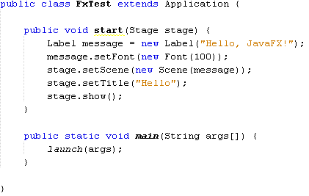
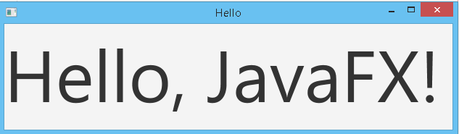
JavaFX (cont.)
In JavaFX, you put everything you want to show onto a scene.

Slide 27
JVM Internals
Permanent generation has been completely removed in JDK 8.
Options PermSize and MaxPermSize have also been removed in JDK 8.
In JDK 8, classes metadata is now stored in the native heap and this space is called Metaspace.
There are some new flags added for Metaspace in JDK 8:
-XX:MetaspaceSize=<NNN> where <NNN> is the initial amount of space(the initial high-water-mark) allocated for class metadata (in bytes) that may induce a garbage collection to unload classes.
-XX:MaxMetaspaceSize=<NNN> where <NNN> is the maximum amount of space to be allocated for class metadata (in bytes). This flag can be used to limit the amount of space allocated for class metadata.By default there is no limit set.
-XX:MinMetaspaceFreeRatio=<NNN> where <NNN> is the minimum percentage of class metadata capacity free after a GC to avoid an increase in the amount of space (high-water-mark) allocated for class metadata.
-XX:MaxMetaspaceFreeRatio=<NNN> where <NNN> is the maximum percentage of class metadata capacity free after a GC to avoid a reduction in the amount of space (high-water-mark) allocated for class metadata.
By default class metadata allocation is only limited by the amount of available native memory.

Slide 28
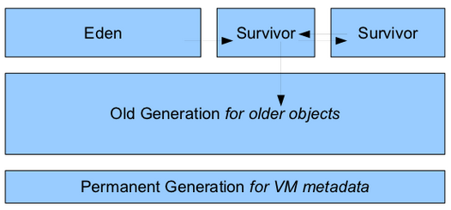
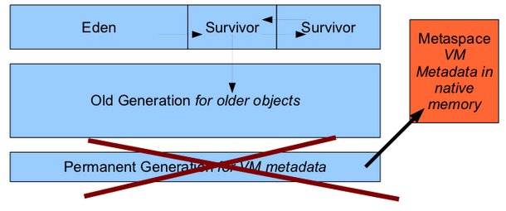
JVM Internals (cont.)
Heap Structure in Java 6 →
JVM Metadata→

Slide 29
Other Improvements
Integer types now support unsigned arithmetic.
The Math class has methods to detect integer overflow.
Java 8 brings a small number of convenience methods that use streams for reading lines from files and for visiting directory entries.
For many years, the JDK had a nonpublic class java.util.prefs.Base64 and an undocumented class sun.misc.BASE64Encoder. Java 8 provides a standard encoder and decoder java.util.Base64.
Java 8 has two enhancements to annotation processing: repeated annotations and type use annotations.
Reflection has been enhanced to report method parameter names.
In Java 8, JDBC has been updated to version 4.2.

Slide 30
Conclusions
Java 8 is a revolutionary release of the world’s #1 development platform.
It includes a huge upgrade to the Java programming model.

Slide 31

Bibliography
http://en.wikipedia.org/wiki/Java_(programming_language)
Oreilly Java 8 Lambdas (Mar 2014)
AWP Java SE 8 for the Really Impatient

